Slide 1
Analyzing Flight Delays Between ORD & LAX between 2013-2022
Maggie Guo Chen, Carolyn Liu, Olivia Pinney,
Eujene Yum, Sabrina Yusoff

Slide 2
Agenda
Problem Statement
Data Collection
General Process
Models
Seasonal Naive
SARIMA
Regression
Regression with ARIMA errors
Dynamic Harmonic Regression
TBATS
Conclusion

Slide 3

Problem Statement
You want to escape the Chicago cold, but hate airport delays….
Can we predict the severity of delays (in minutes) for flights that operate to and from ORD and LAX?
Variable of Interest: Avg Arrival Delay (Minutes)

Slide 4

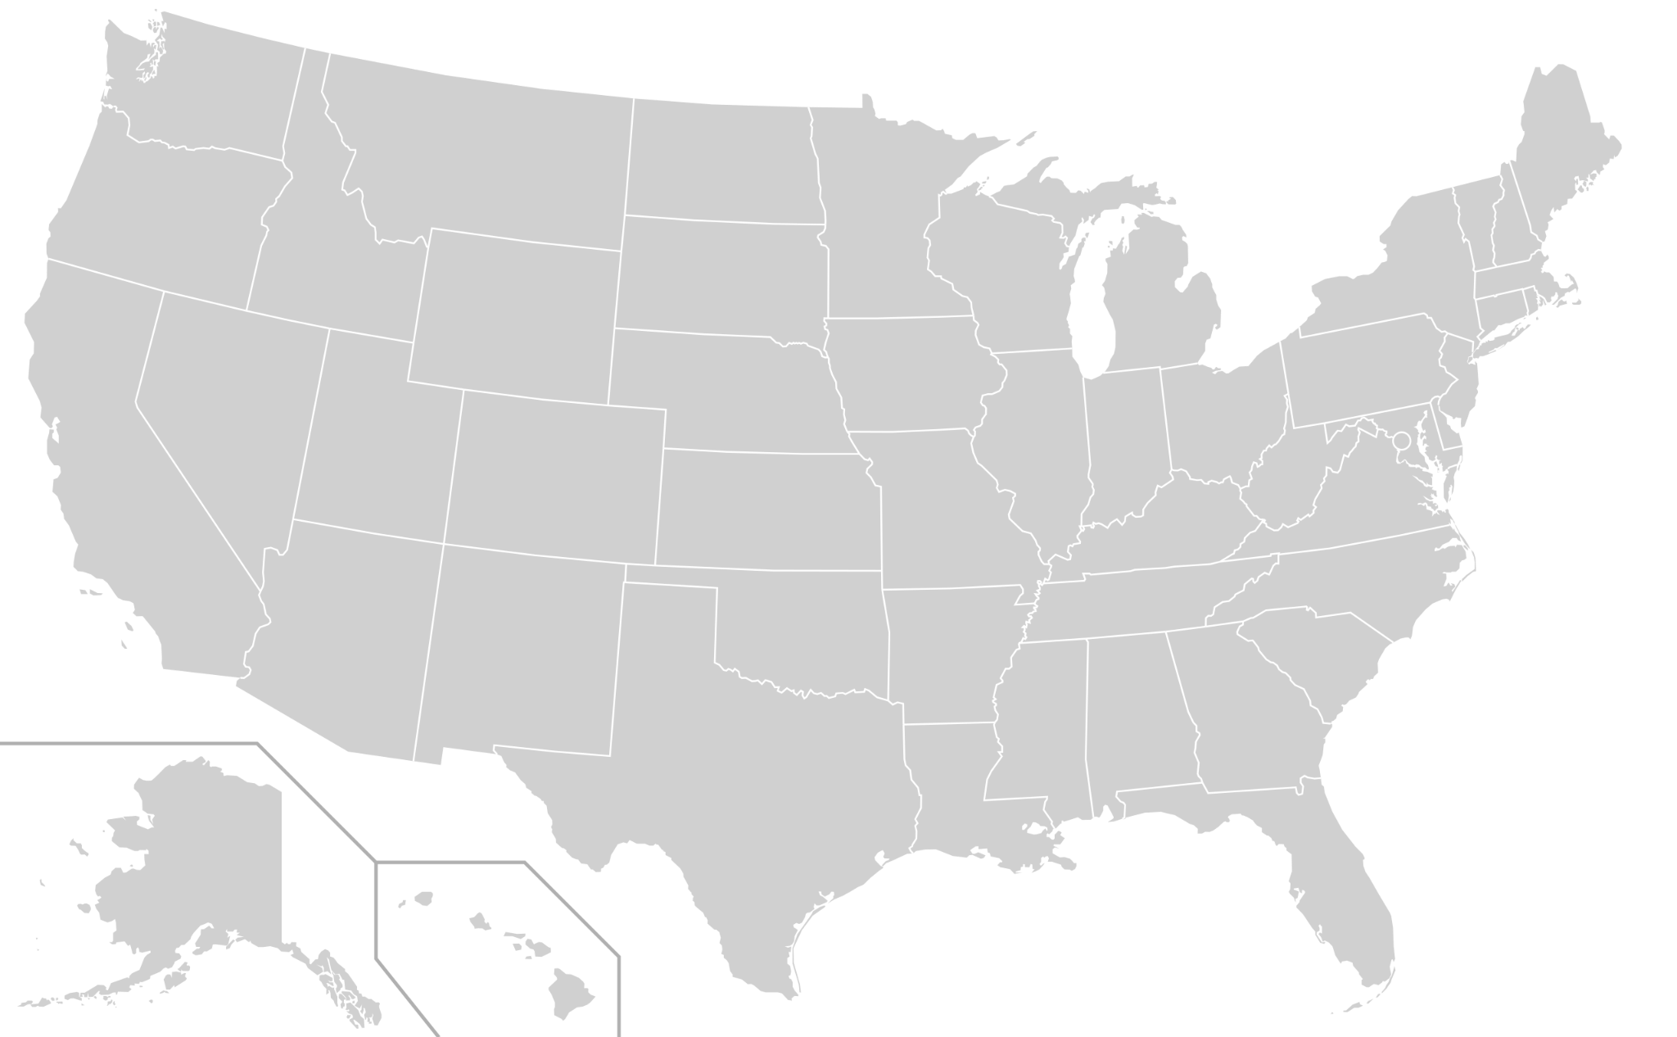
Data Collection
We use data from the Bureau of Transportation Statistics to look at flight data to and from LAX and ORD and look into delay and cancellation metrics.

Slide 5
Process
Downloaded data from January 2013 to October 2022 with the relevant fields including delay (in minutes) for arrival
Examined data for seasonality and trend, and transformed for stationarity
Aggregated data to weekly frequency for meaningful forecast
Average delay calculated at frequency of 53 times per year
Measured accuracy of forecast models on excluded test sets
Trained model on 01/01/2013 - 12/31/2018 time series
Tested model on 01/01/2019 - 12/31/2019 time series
Additional forecasting for 01/01/2020-08/31/2022 to see if model holds for Covid impacts

Slide 6
Models
Seasonal Naive
SARIMA
Regression
Regression with ARIMA errors
Dynamic Harmonic Regression
TBATS

Slide 7
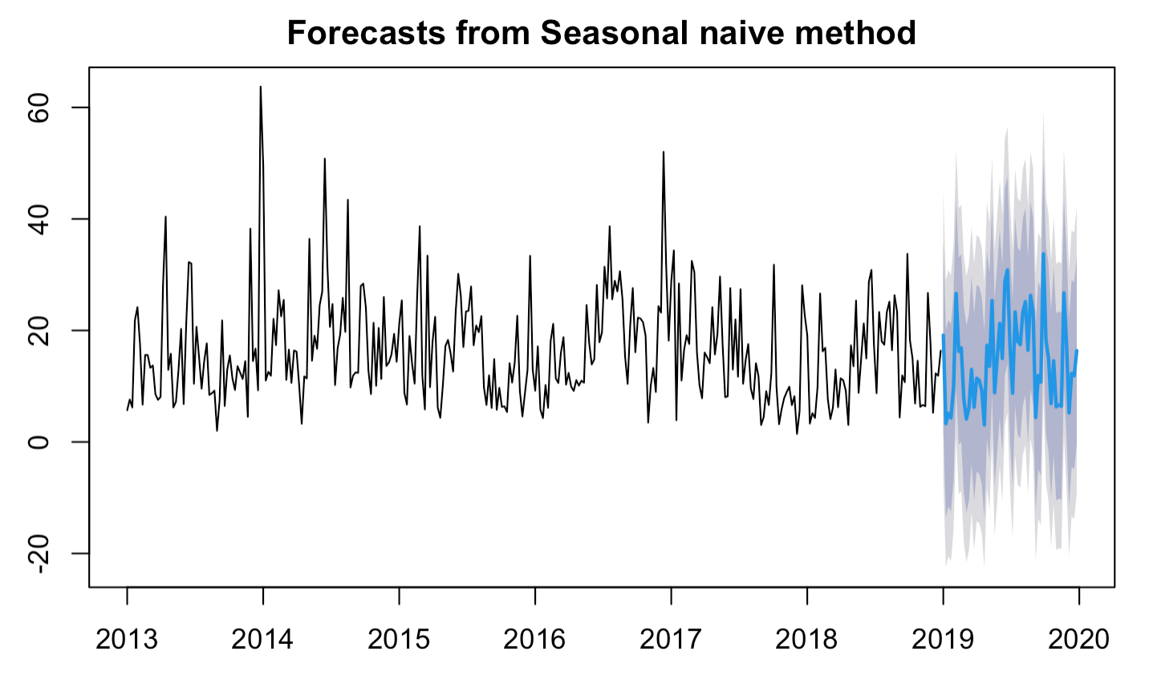
Seasonal Naive
Seasonal naive model repeats the last seasonal component
This is our baseline model - more complex models will ideally perform better
SNaive RMSE: 9.9443

Slide 8
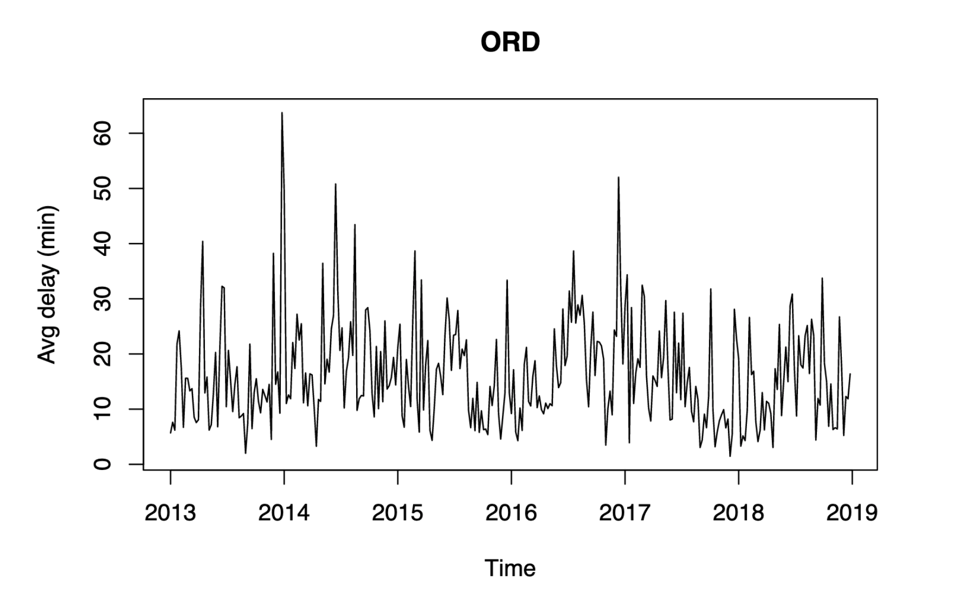
SARIMA - Raw data requires transformation
Data is not stationary
Clear seasonality
Variance is not constant

Slide 9
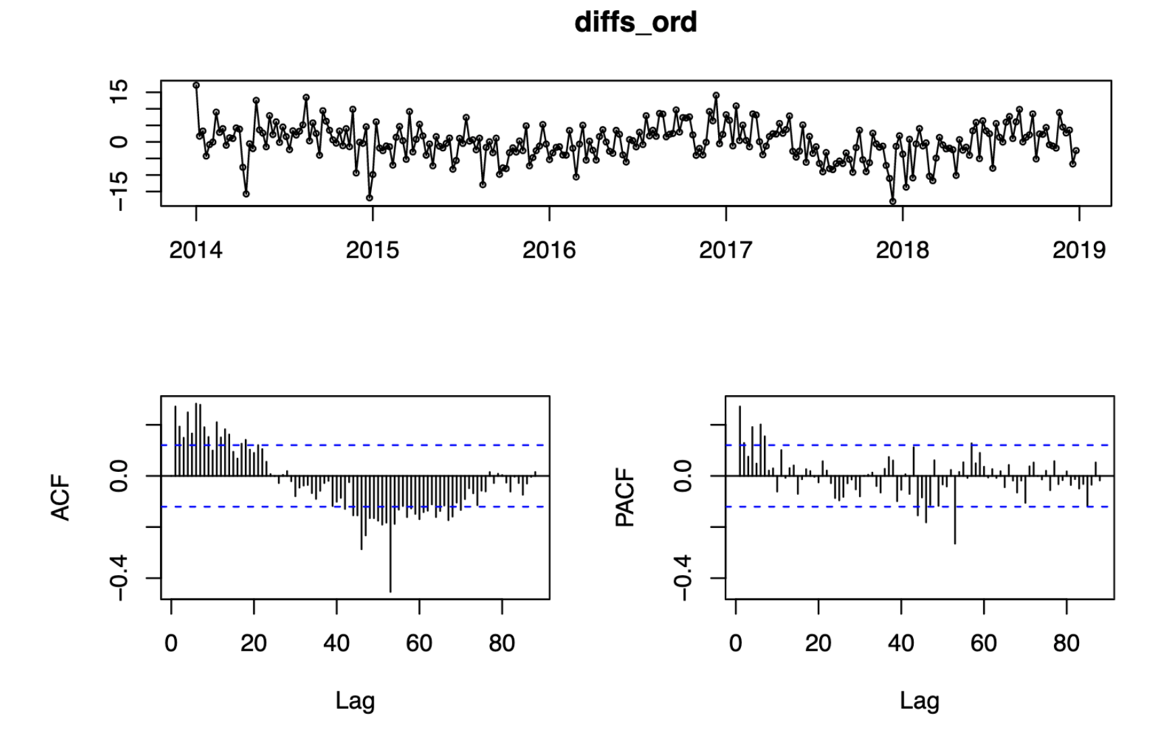
SARIMA - Data post-transformation
Step 1: Box-Cox Transformation λ = 0.7
Step 2: Seasonal Differencing (D=1) with lag = 53
All variables are stationary
KPSS test fails to reject the null (time series is trend stationary)
Notes:
HOW TO TALK ABOUT ACF PACF HERE?

Slide 10
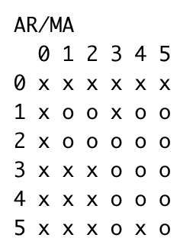
SARIMA - Model Specification
1. Find the order for both seasonal and non-seasonal parts
p = 1, q = 1
seem like good candidates…
…Loop through 0, 1, 2 to find best p, q, P, Q values
2. Final ARIMA model : ARIMA(1,0,2)(0,1,2)[53]
AICc: 1513
RMSE: 7.9638
Ljung-Box test (p=0.2727) fails to reject the null and residuals are independently distributed

Slide 11
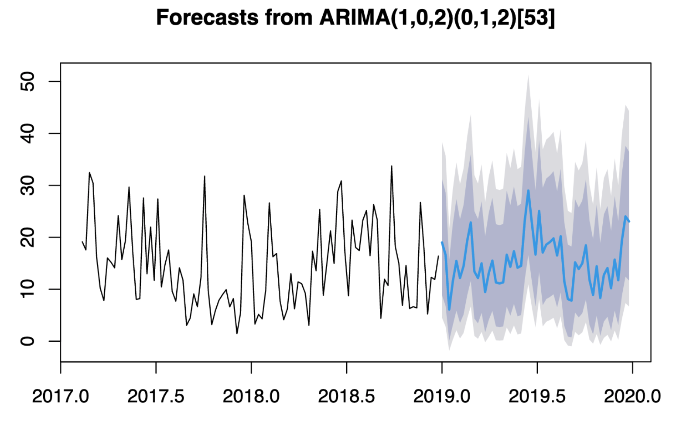
SARIMA - Forecasted Average Delay a Year Out
SARIMA RMSE: 7.9638
At a glance, forecast seems to follow previous trend and seasonal patterns
Notes:
Next, we compare our forecast to actual delays and seasonal naive…

Slide 12
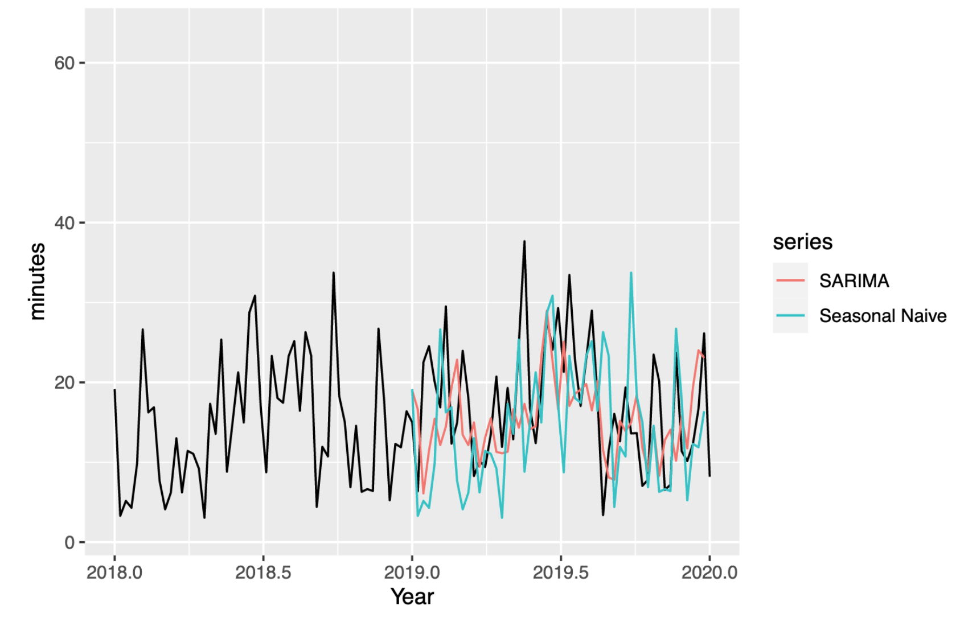
SARIMA - Forecasting
SNaive RMSE: 9.9443
SARIMA RMSE: 7.9638

Slide 13
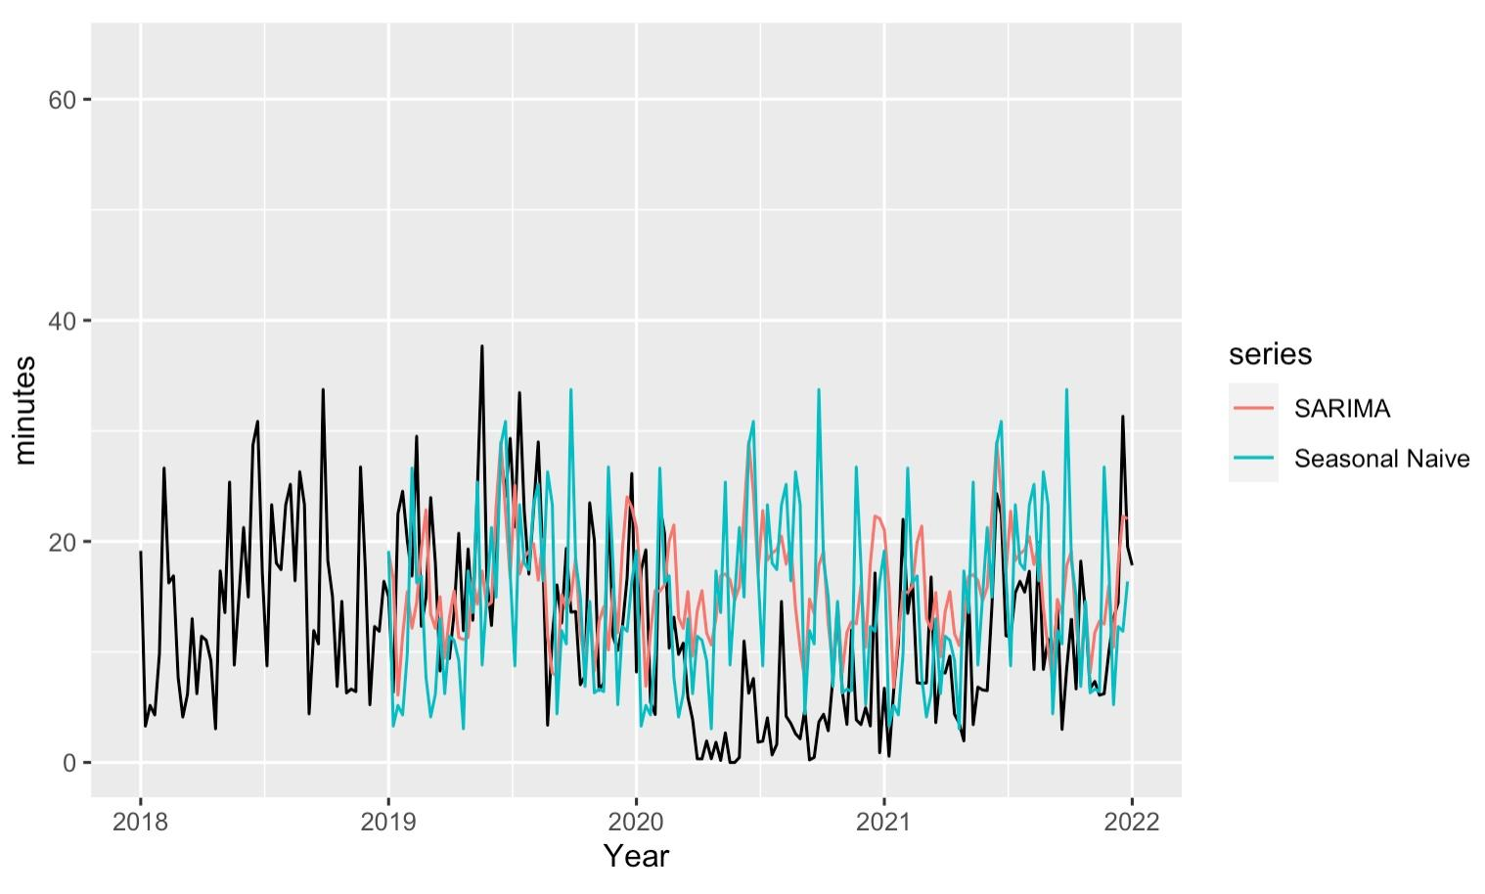
SARIMA - Forecast vs Covid Impact
SNaive RMSE: 9.9641
SARIMA RMSE: 8.0876

Slide 14
Regression
Our baseline regression model does not give satisfactory performance
1. Model Description
2. Baseline Model Output
Covariate | Estimate | If Significant
weather_delay_cnt | 0.58297 | Yes
nas_delay_cnt | 0.35555 | Yes
security_delay_cnt | 1.46885 | No
aircraft_delay_cnt | 0.49413 | Yes
carrier_delay_cnt | 0.08037 | No
External
weather_delay_counts
Arrival Average Delay
(ORD data)
nas_delay_counts
security_delay_counts
Residuals have
Ljung-Box p-value <2.2e-16
still a big space for the model to improve and capture more patterns in the data
Internal
aircraft_delay_counts
carrier_delay_counts

Slide 15
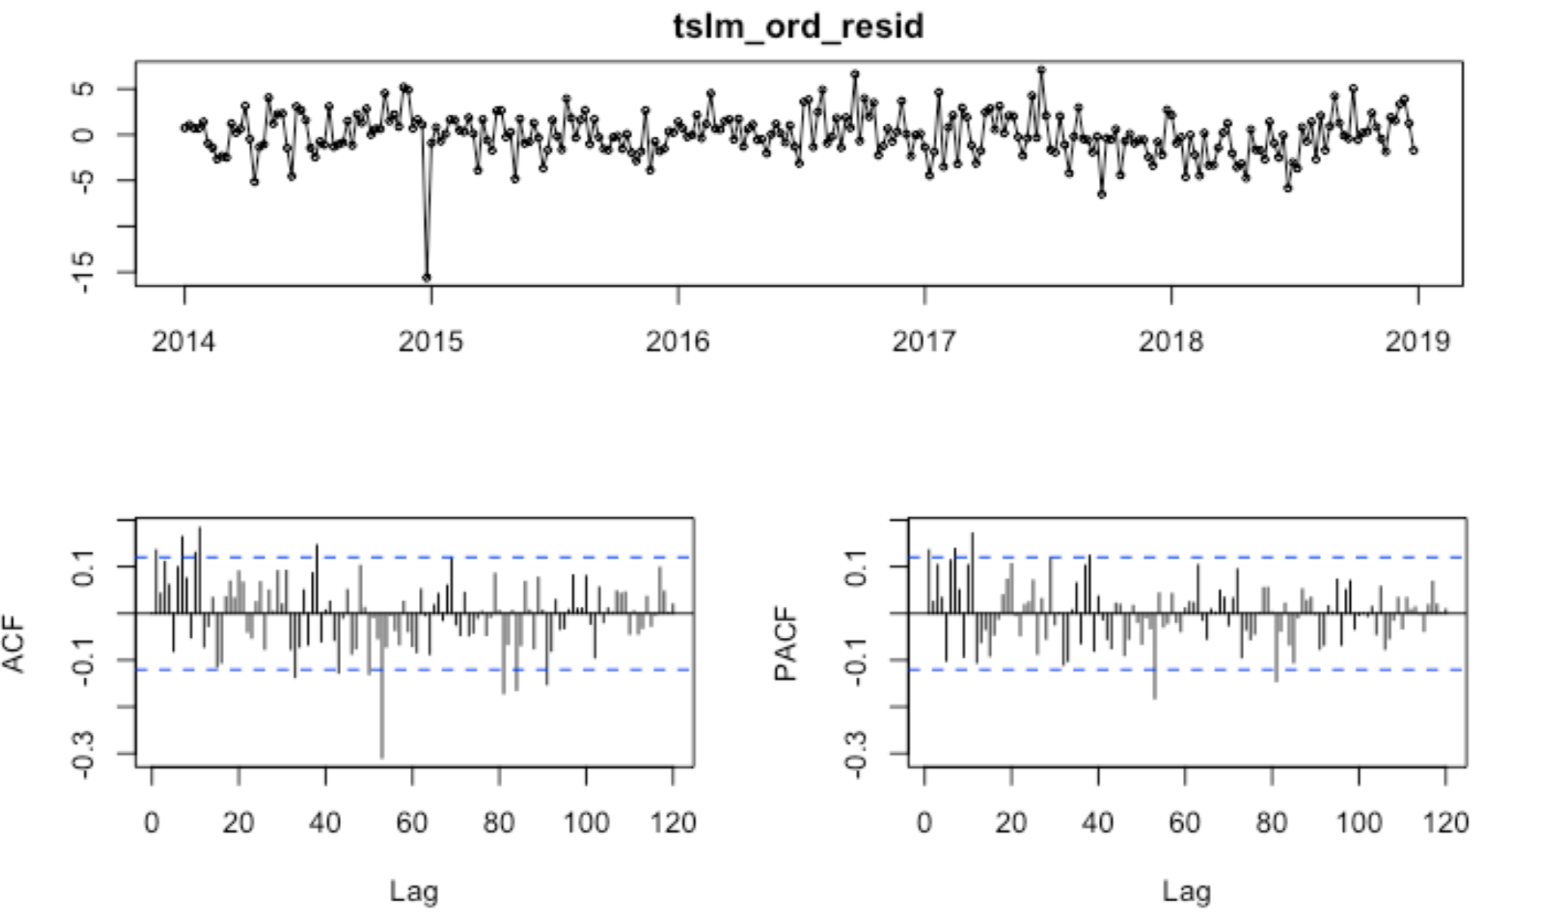
Before using ‘Regression + ARIMA error’ model, we made all variables stationary and examined the residuals from tslm model
1. Process Variable
2. Fit Model & Examine Residuals
Step 1: Box-Cox transformation
Step 2: Seasonal differencing
(D = 1)
All variables are stationary,
with same differencing applied
Step 1: tslm model fitting
Step 2: examine residuals
Covariate | P value from KPSS
weather_delay_cnt | 0.1
nas_delay_cnt | 0.1
security_delay_cnt | 0.1
aircraft_delay_cnt | 0.1
carrier_delay_cnt | 0.07166
Residuals are NOT white noise

Slide 16
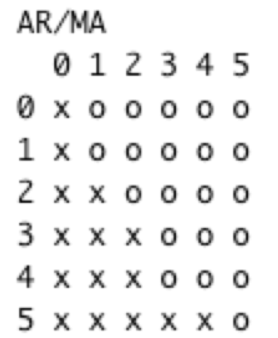
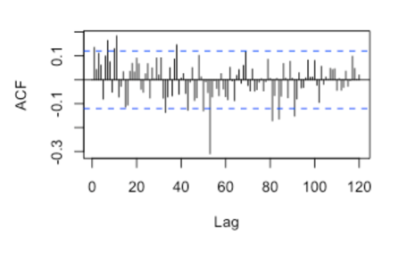
After finding the best order for non-seasonal and seasonal parts, our Regression + ARIMA model gives good performance on training data
1. Find the order for both seasonal and non-seasonal parts
p = 1
q = 1
Q = 1
2. Compare with auto.arima(), examine coefficients for business implications
auto.arima()
ARIMA(1,0,1)(1,1,0)[53]
AICc: 1192.27
RMSE: 4.81
our model
ARIMA(1,0,1)(0,1,1)[53]
AICc: 1176.49
RMSE: 4.44675

Slide 17
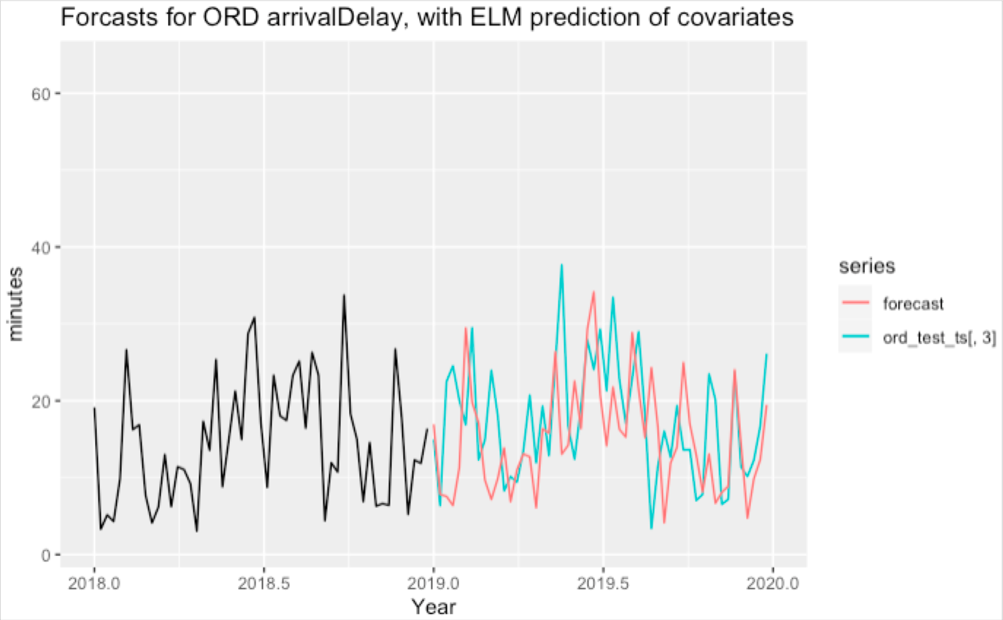
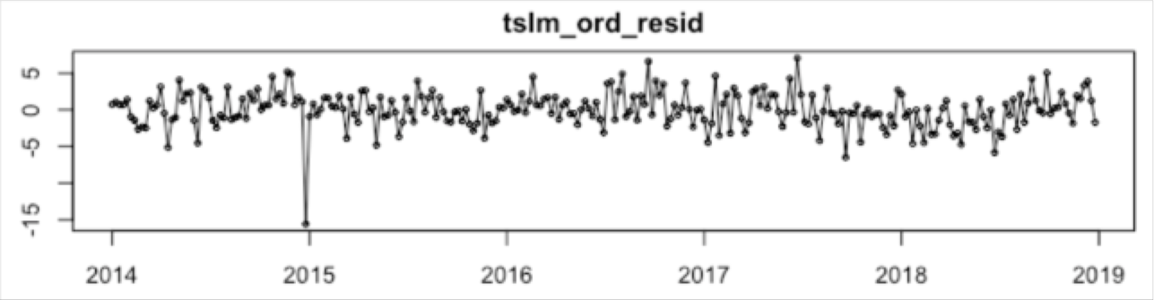
Our ‘Regression + ARIMA error’ model captures trend and seasonality in testing dataset, but there is still space for improvement
1. Trend and seasonality are captured
2. ELM() forecast gives best RMSE
Forecast Method | Testing RMSE
snaive() | 8.57
tbats() | 7.87
nnetar() | 8.66
elm() | 7.77
Ljung-Box test p-value: 0.004222

Slide 18
Harmonic - Set Up
Uses Box-Cox transformation
Lambda = 0.7
Requires stabilized data for periodogram
No longer use seasonal differencing
Regular differencing not required because KPSS test says we can accept the null hypothesis that our data is stationary at p-value 0.1>0.05
Multi seasonal time series requires specification of frequencies
frequency = 53
seasonal.periods = ?

Slide 19
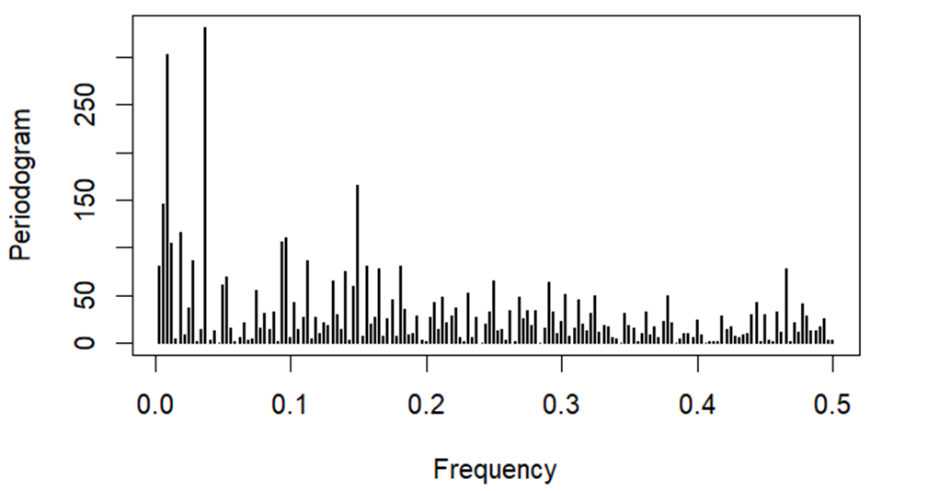
Harmonic - Periodogram
The periodogram identified two frequencies: ½ a year and 2 years
The 1 year frequency came in 5th
1
2
 | Spec | Freq (weeks) | Freq (years)
1 | 330 | 26.67 | 0.5
2 | 303 | 106.67 | 2
3 | 166 | 6.67 | 0.125
4 | 146 | 160 | 3
5 | 116 | 53.33 | 1
5

Slide 20
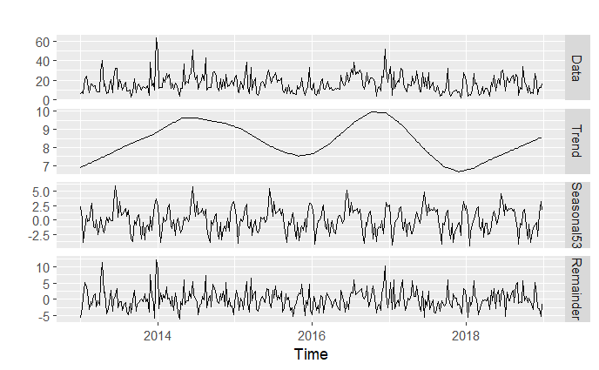
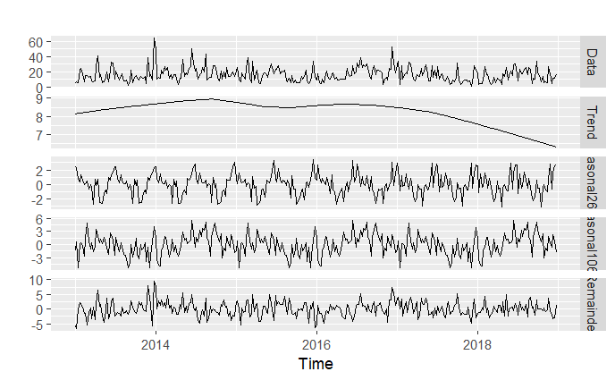
Harmonic - Count of Frequencies
Two seasonal terms (26.67 and 106.67) are sufficient to capture seasonality while one seasonal term (26.67) is not sufficient
Seasonal periods = (26.67)
Seasonal periods = (26.67, 106.67)

Slide 21
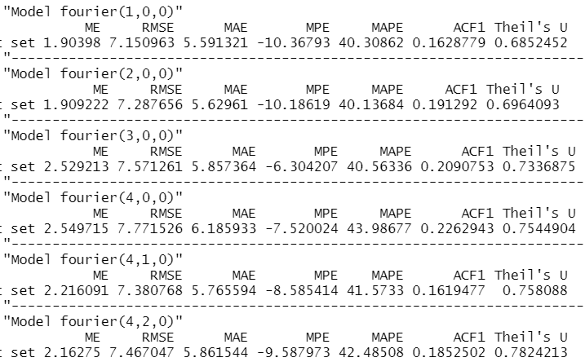
Harmonic - Turning Fourier Series and ARIMA Error
Iterate through Fourier Series specifications
Define Fourier(c(k1,k2,k3)) for seasonal frequencies of 26.67, 106.67 and 53
Tried k1 from 1:10, k2 from 1:10 and k3=0
Picked models with low RMSE, low complexity and white noise ARIMA error
Selected six Fourier models to tune
Modeled ARIMA errors
Compared RMSE on testing data
Fourier(1,0,0) and ARIMA(1,0,0) performs best on the testing data, while
Fourier(4,1,0) and ARIMA(2,0,1) performed best on the training data

Slide 22
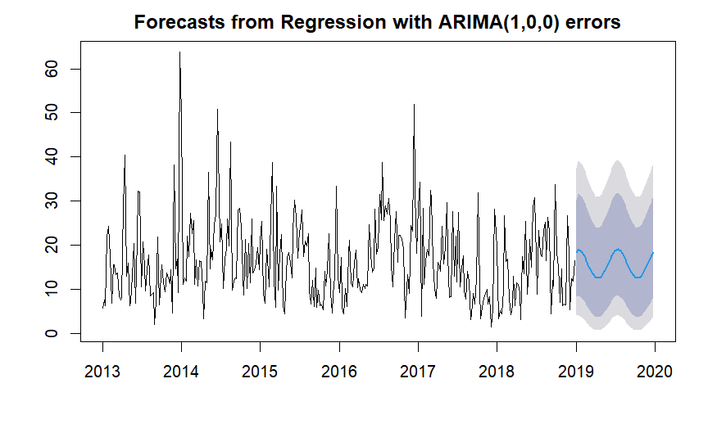

Harmonic - Forecasts
Fourier(1,0,0)
Residuals are White Noise
Fourier(1,0,0) Ljung-Box Test p-val: 0.078 < 0.05
Fourier(4,1,0) Ljung-Box Test p-val: 0.295 < 0.05
Accuracies are strong
Fourier(1,0,0) RMSE: 7.150973
Fourier(4,1,0) RMSE: 7.380776
Models are Simple
Fourier(1,0,0) is simpler due to fewer Fourier and ARIMA coefficients to estimate
Fourier(4,1,0)
Pick Fourier(1,0,0)

Slide 23
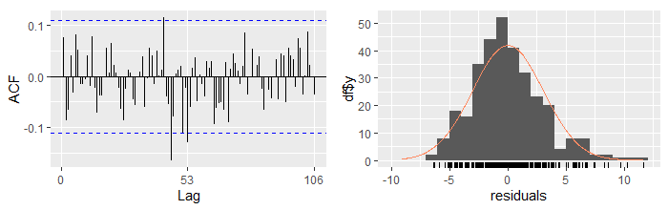
TBATS - Automated
TBATS model is highly automated
Lambda = 0.669
Package selected seasonal frequencies {<53,8>}
Translates to annually and every 8 weeks
Resulting model has white noise error
Ljung-Box Test p-val: 0.2349 > 0.05

Slide 24
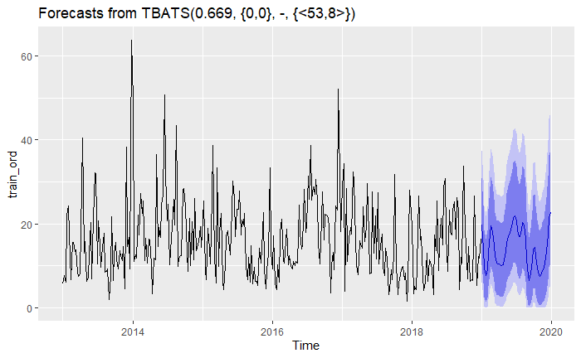
TBATS - Forecast
Accuracy is stronger than seasonal naive, but weaker than Harmonic MSTS
RMSE: 7.847655

Slide 25
RMSE Comparisons
Model | RMSE
Seasonal Naive | 9.94
Seasonal ARIMA | 7.96
ARIMA with errors | 7.77
Harmonic MSTE | 7.15
TBATS | 7.85

Slide 26
Next Steps
Explore extreme outliers (e.g. large drop average arrival delay in 2015) that may have driven significant autocorrelations in residuals of the model
Explore cancellations data for a more complete picture of flight disruptions
Use more detailed covariates to predict delays, such as severe weather events

Slide 27
Thank you!

Slide 28
Team Member Contributions
Name | Contributions
Maggie Guo Chen | Extract data Regression & ARIMA with errors Slides
Carolyn Liu | Extract data Seasonal naive & SARIMA Slides
Olivia Pinney | Extract data Harmonic & TBATS Slides
Eugene Yum | Extract data Seasonal naive & SARIMA Slides
Sabrina Yusoff | Extract data Regression & ARIMA with errors Slides

Slide 29
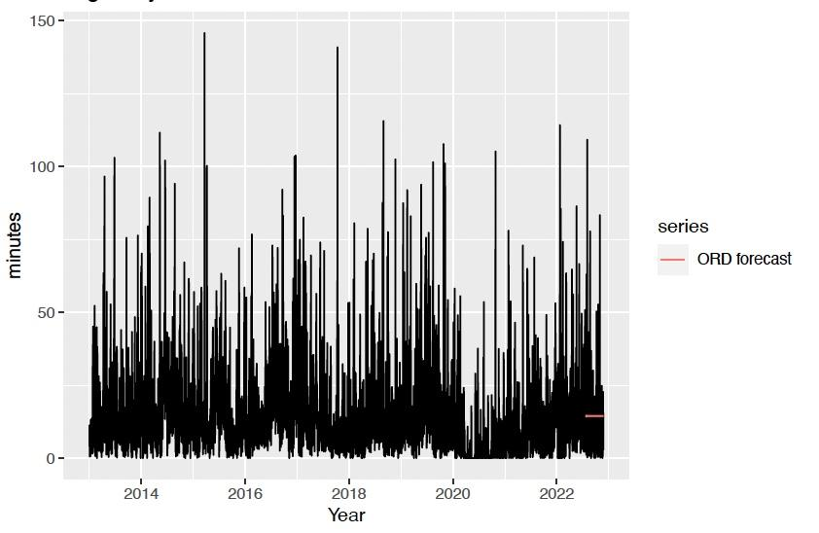
Bonus: Why daily/hourly didn’t work
Daily Data (h = 122)
The frequency was too high for what we were trying to forecast
ARIMA model converged to the mean, rendering our forecast meaningless

Slide 30
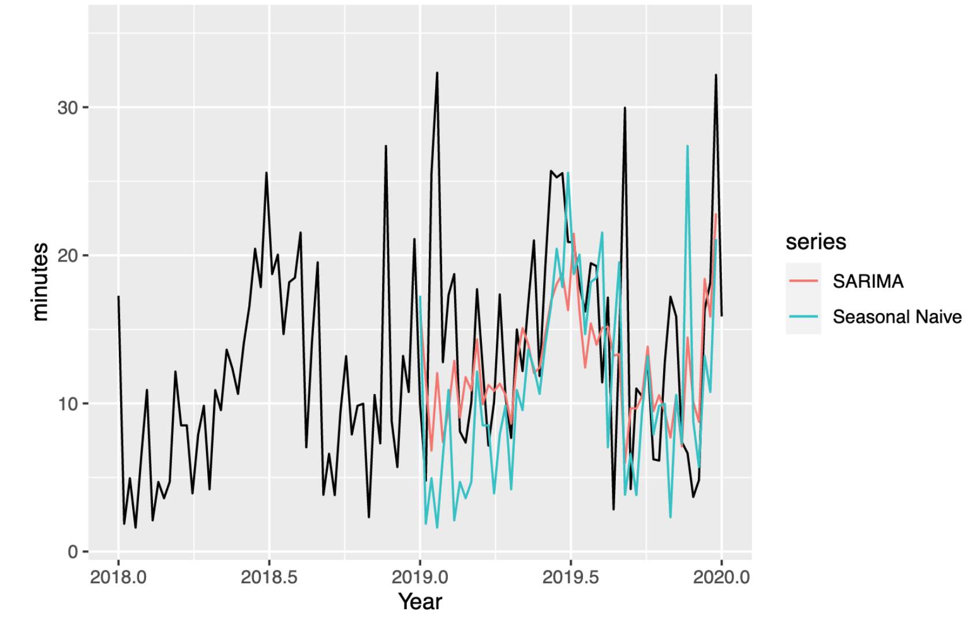
SARIMA - Forecasting (quick look at LAX)
SNaive RMSE: 9.1001
SARIMA RMSE: 6.9387

